Slide 1
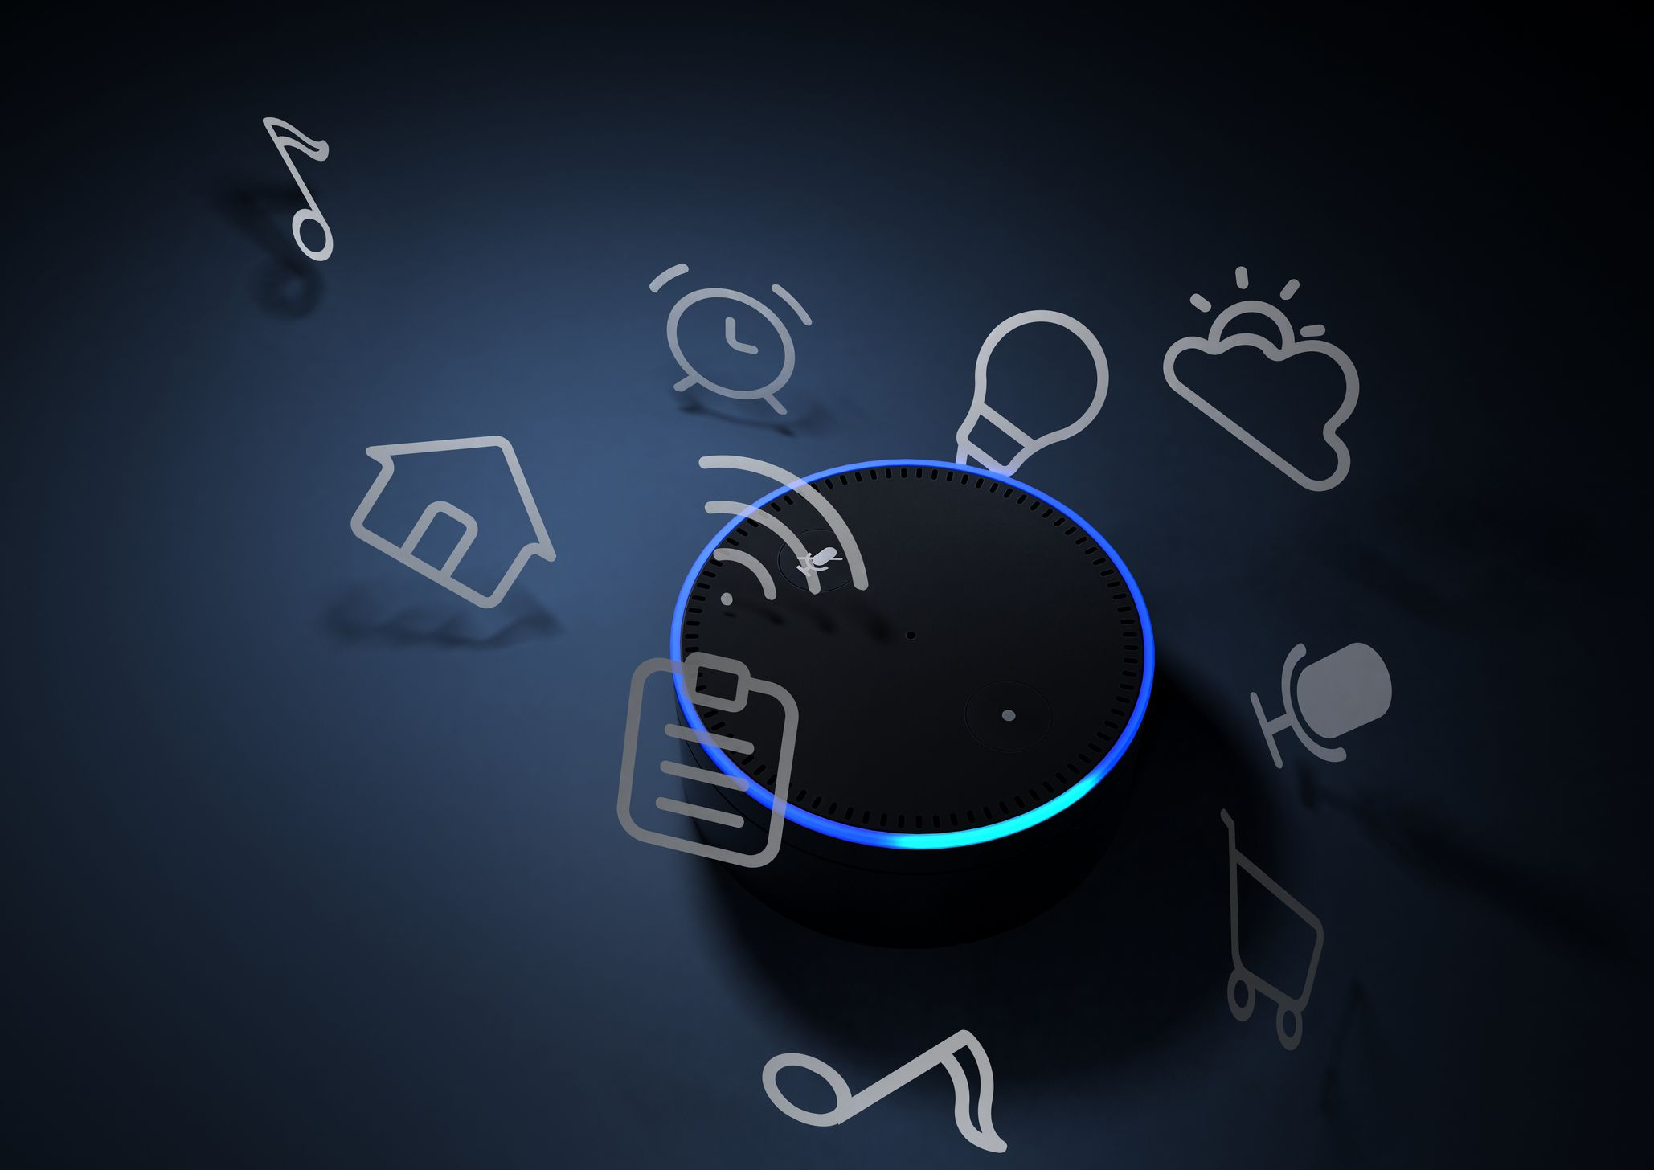
Mini Alexa
Programming in python [ce259]
Prepared by:
Om tank (19dcs147)

Slide 2
CONTENTS
Introduction
Why Alexa is required ??
How does Alexa respond ??
Requirements
Snapshots
Video
Limitations
Conclusion

Slide 3

INTRODUCTION
Alexa is the virtual assistant Artificial Intelligence technology built for easier and comfortable living of the people.
Alexa is the voice service that enables people to interact with devices in a more intuitive way using the voice.
Nowadays, Alexa is getting is more and more smarter by controlling several smart devices using itself as a home automation system.

Slide 4

Why Alexa is required ??
The past decade has been dominated by the touch screen devices.
But now, a new revolution is brewing voice-controlled systems powered by Artificial Intelligence.
Through your own voice , you can control things that you control via touch though.
Instead of controlling everything via apps, we can able to talk to our virtual assistants to control everything from our computers to our home lighting.

Slide 5
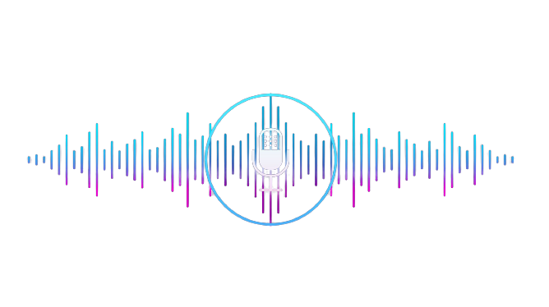
How does Alexa respond ??
Most devices with Alexa allow users to activate the device using a wake-word such as Alexa through which it gets to know of doing things.
Users make some requests from their personal or shared devices and Alexa recognizes it.
After that, it looks for the specific word in the sentence and search for it.
Then it replies with the satisfied output if it gets to recognize the sentence.

Slide 6
REQUIREMENTS
HARDWARE :
The memory requirement may be higher or lower depending on the complexity of the gadget.
Your gadget must support Bluetooth 4.2 or above. This can be Classic Bluetooth or Bluetooth Low Energy.
SOFTWARE :
Python 3.8 or higher version.
Pip for python packages and modules.
Libraries and Modules for speech recognition, wikipedia, pywhatkit, pyjokes and many more.

Slide 7

SNAPSHOT / VIDEO :

Slide 8
LIMITATIONS
There should be very specific word for searching or doing things.
Enough knowledge limitation.
We can’t change virtual assistant’s name.
Limited to some distance only.
Can’t perform the multiple actions with the one command.
Can’t perform phone calls as it requires your phone to do it.

Slide 9
CONCLUSION
From this project, we can draw a conclusion that smart devices and virtual assistants like Alexa are changing the world very widely.
Alexa should reach out to every person in the world for better living of the people and can be more effective than humans.
This can develop into a capable information and controlling tool in the near future.

Slide 10


